Slide 1
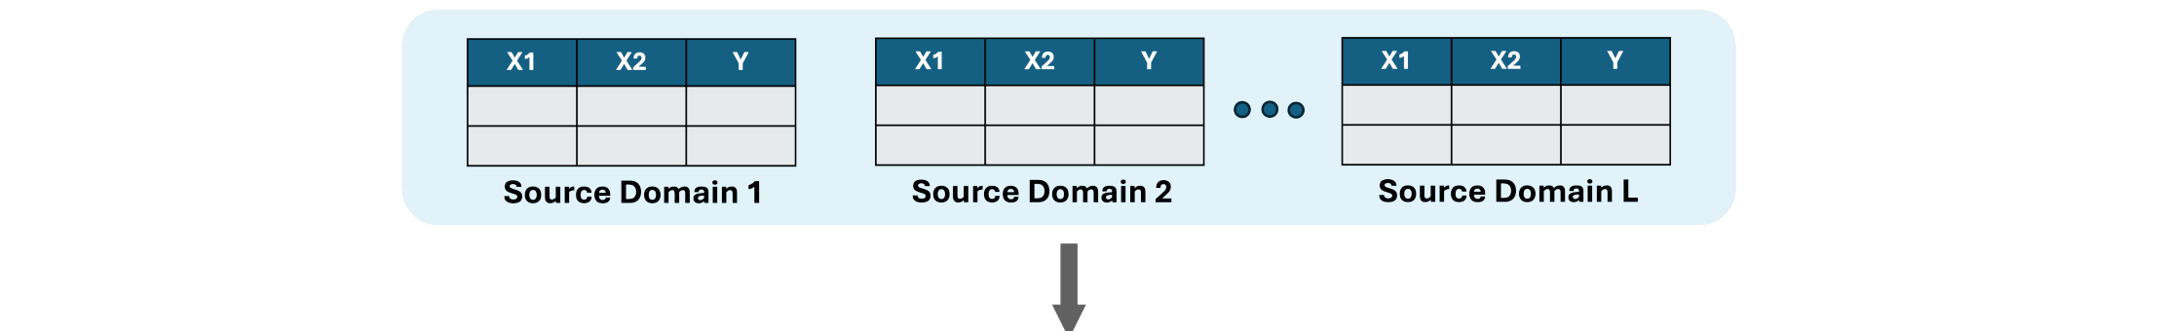
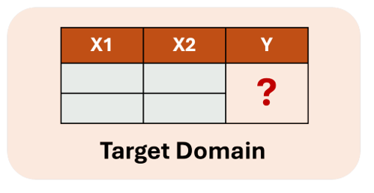
Our Framework: Multi-source Unsupervised Domain Adaptation (MSDA).
Each target domain is a mixture of other distributions, the weight determined by learning

